Slide 1
How to familiarize yourself with phishing attacks

Slide 2
What is phishing?
Scammers pretending to be trusted entities to trick you into giving sensitive information
  Log in credentials, credit card info, company data to name a few
Comes with a sense of urgency to the victim
  This gets them to act quickly without thinking

Slide 3
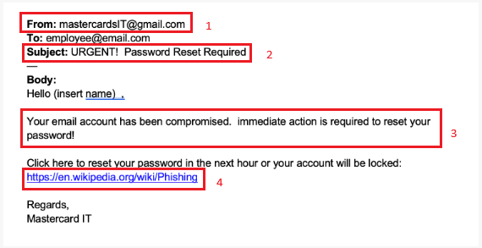
How to spot phishing attempts
Always check the email address from the sender.
Check for urgency.
Check for poor formatting in the body of the email.
Never click on any links in the email if there is any suspicion, if there are any links.

Slide 4
How to prevent getting phished
Keep calm if there is a sense of urgency in an email you didn’t receive.
As stated in number 4 of the previous slide, do not be hasty and click on any links or attachments.
Do your due diligence.
  Assess whether or not you were expecting an email from the sender.
Trust your gut.
  If something is off about an email, there’s probably a good reason for it.

